Slide 1
The Electrical Prober
Rebuilding wafer-probe test automation from the ground up
A non-technical overview
Internal engineering overview

Slide 2
BACKGROUND
Why This Project Exists
▸ The old system ran on LabVIEW — a graphical programming tool that has powered our wafer probers for years, but is expensive to license, slow to change, and increasingly hard to find engineers who know it well.
▸ It was built assumption by assumption for the exact hardware in front of it — adding a new product, probe card, or instrument usually meant rewiring the underlying program itself, not just changing a setting.
▸ The goal: rebuild the same capability in Python — a free, modern, widely-known language, with a real codebase that can be version-controlled, tested, and handed off to the next engineer without a specialty tool.
▸ Nothing about how the wafer probers or instruments physically work changed — the new software just talks to the same hardware in a cleaner, more flexible way.
2

Slide 3
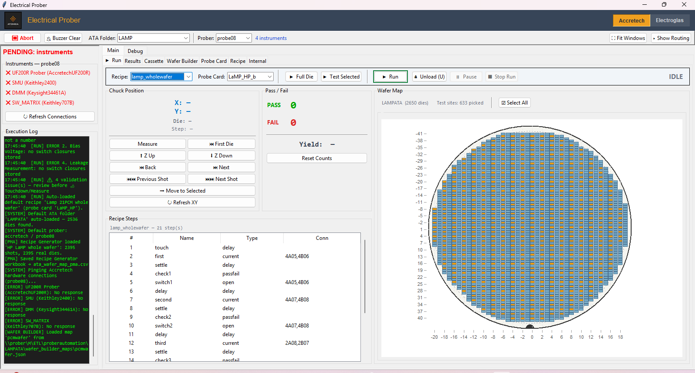
OVERVIEW
What the GUI Does, In General
In one sentence: it drives a robotic wafer prober and its lab instruments to automatically electrically test every chip on a silicon wafer, one at a time - then shows the results back live, on screen, as they happen.
One application covers the whole job end to end: setting up what to test, running the test, watching it happen, and getting the data out the other side - instead of several disconnected tools stitched together.
Running a wafer live - position, pass/fail, and yield update in real time
3

Slide 4
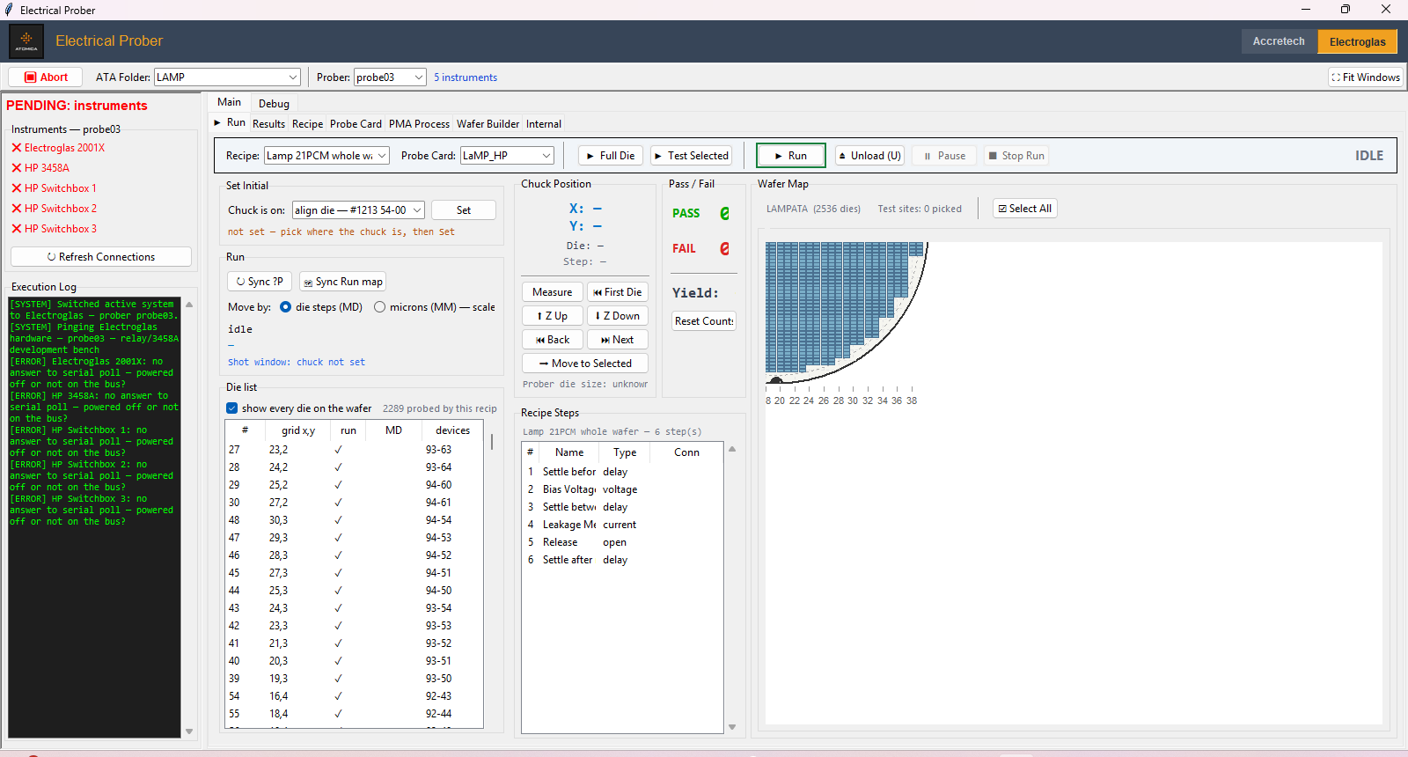
MODERNIZING THE BENCH
One Modern Program, Two Aging Machines
The lab runs two physically different prober systems - Accretech and Electroglas - from two different manufacturers, each with its own control software and its own age.
The Electroglas system's original control software was still tied to Windows XP - an operating system Microsoft stopped supporting years ago, with no security updates and shrinking hardware compatibility.
The new application replaces both machines' aging, single-purpose control software with one modern program on modern Windows, with a single toggle to switch between them. Recipes, wafer maps, results, and exports all work the same way no matter which machine is underneath.
Same GUI, switched to drive the Electroglas system
4

Slide 5
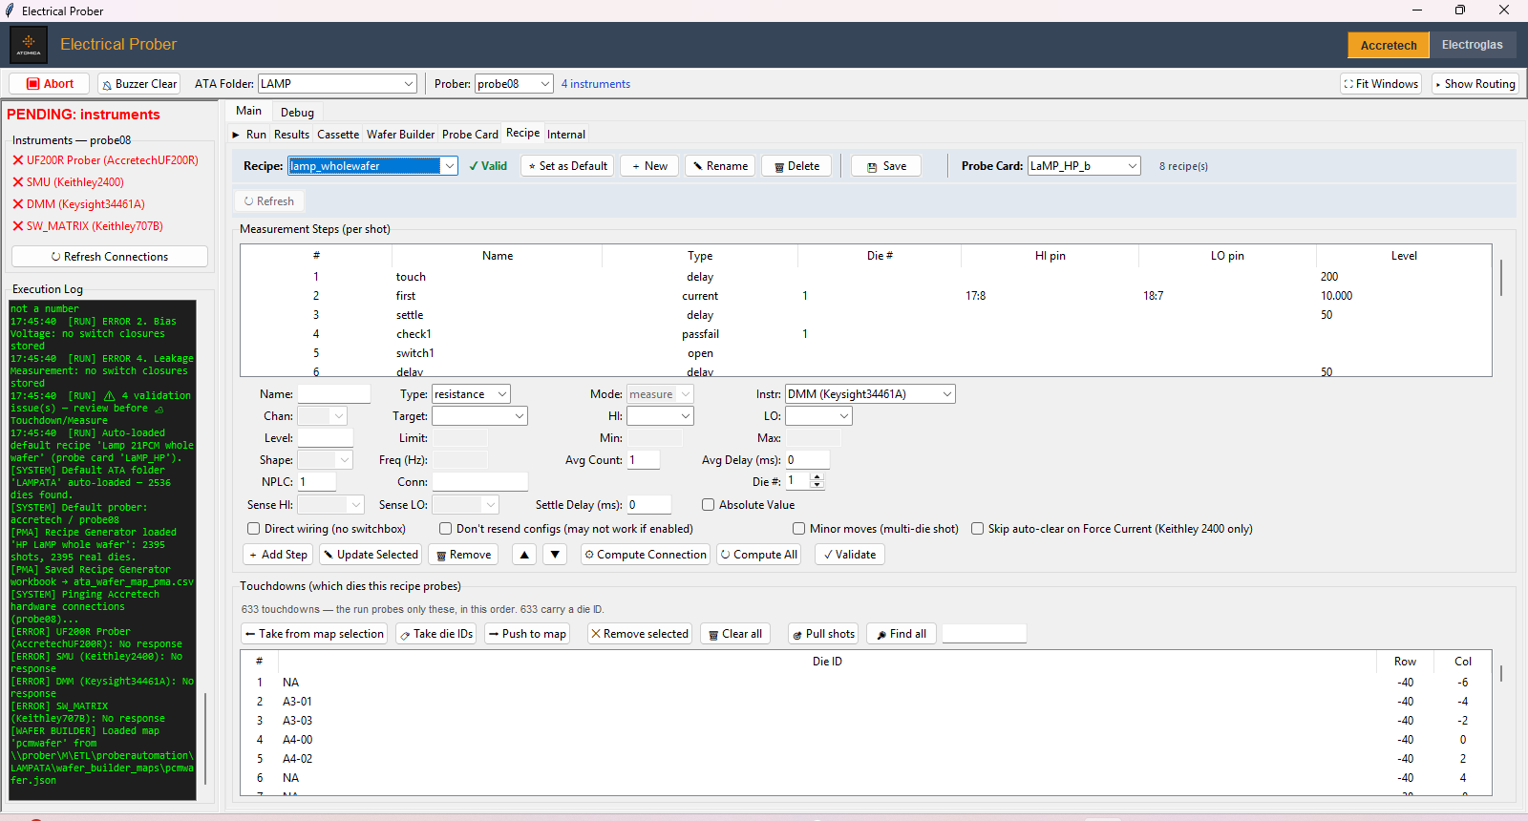
A DIFFERENT PHILOSOPHY
From Hardcoded to Configurable
The old Accretech/LabVIEW system baked its knowledge into the program itself - which pins meant what, which steps a test ran, how a wafer was laid out were effectively wired into the code. A new product often meant a new build, done by someone who knew LabVIEW.
The new GUI turns all of that into ordinary, editable settings: probe card pinouts, test recipes, wafer layouts, and instrument choices are all built and changed directly on screen, by anyone on the team - no programming required.
That single shift is what makes the system genuinely easy to use on a complicated piece of equipment: bringing up a brand-new product is now a configuration task, not a software project.
Building a test recipe by editing steps directly, no code involved
5

Slide 6
HOW IT TALKS TO HARDWARE
A Common Language for Old & New Instruments
▸ GPIB is a decades-old cable standard — still the industry norm for connecting lab instruments (source-measure units, multimeters, switch matrices) to a controlling computer.
▸ Every instrument on the bench - old or new, from any manufacturer - speaks the same basic protocol over it.
▸ The software has one "driver" per instrument model that translates a plain request ("apply 5 volts," "read the current") into the exact commands that model expects.
▸ Because that translation layer is isolated, swapping in a newer instrument - or adding a brand-new one - doesn't require touching the rest of the program.
6

Slide 7
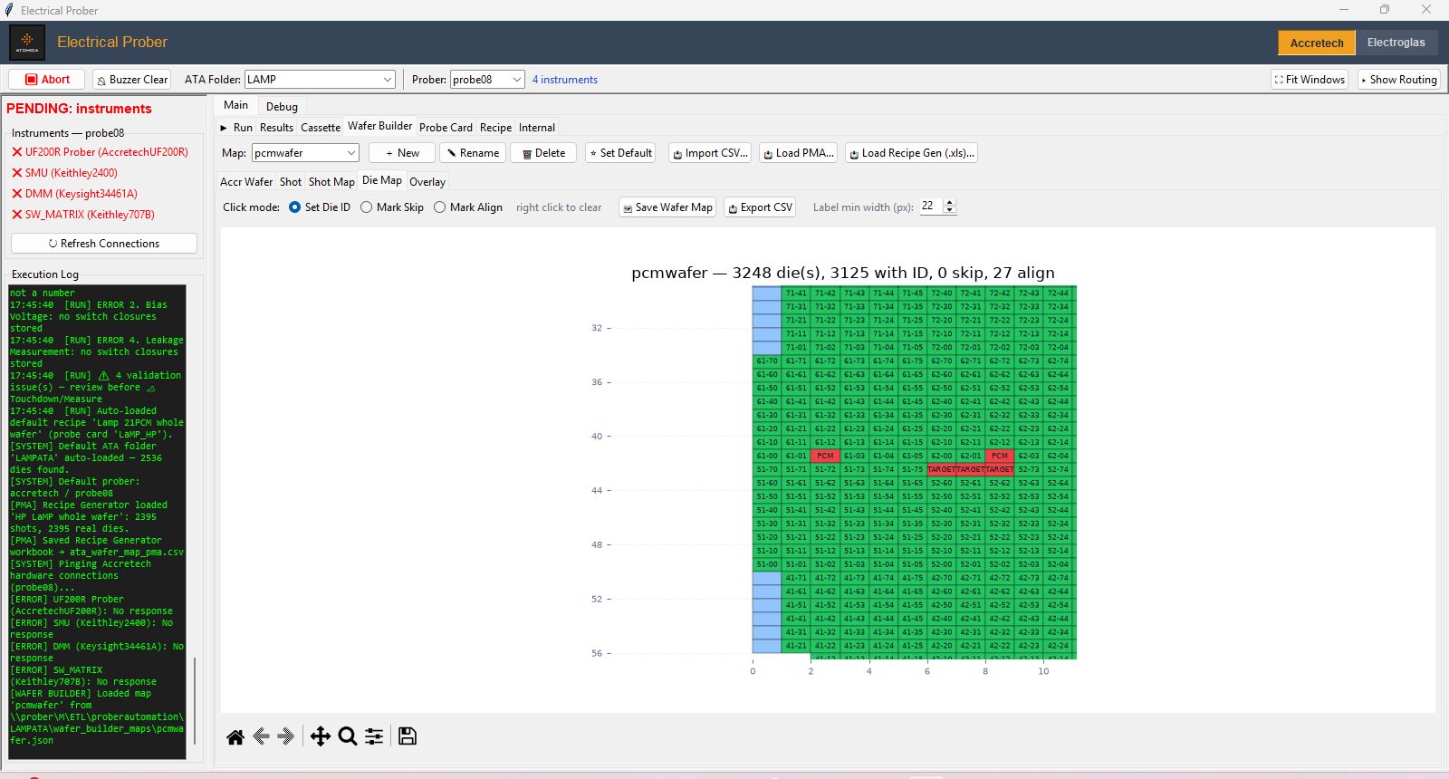
THE CORE IDEA
The Wafer Map: The Real Engine Underneath
Before anything can be tested, the software needs to know the exact layout of the wafer: how many chips ("dies"), how they're arranged in rows and columns, and which ones exist near the wafer's rounded edge.
That map can be built by hand, imported from a design file, or pulled straight from the prober's own hardware - and once it exists, it becomes the shared foundation for everything else: the test recipe walks it, the live run screen tracks position on it, and the results paint pass/fail directly onto it.
It isn't just a picture of the wafer - it's a general "grid of positions, each with its own state" engine that the rest of the program is built around.
Wafer Builder - the shared map every other screen relies on
7

Slide 8
THE CORE IDEA, CONTINUED
The Single Biggest Thing to Reuse
Of everything in this system, the wafer map engine is the most valuable piece to carry elsewhere - because "a grid of positions that each get visited and get a result" shows up far beyond wafer probing.
▸ Any equipment that steps through a fixed layout of positions — a different prober, a socket board, a tray of parts - can reuse the exact same map, without touching how it's drawn or tracked.
▸ The pass/fail-per-position coloring, the click-to-inspect detail, and the "skip/align" handling for irregular edges all come for free — they were built generically, not wafer-specific.
▸ Swapping in a new layout is a data change, not a redesign — the same map component happily describes a round wafer, a rectangular tray, or an arbitrary custom grid.
8

Slide 9
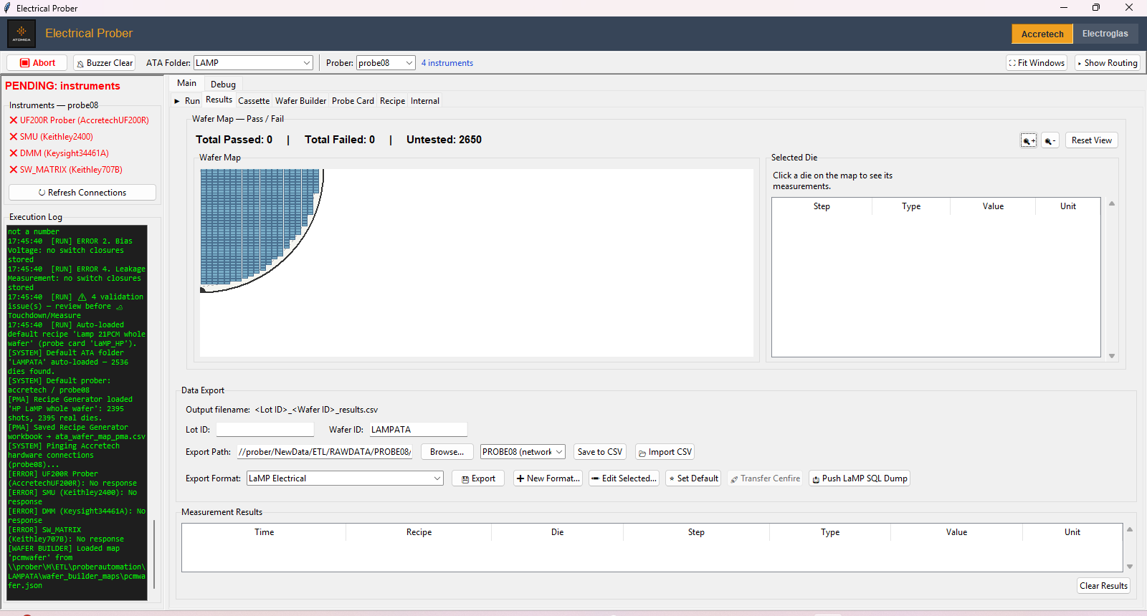
RESULTS
Seeing the Whole Wafer at a Glance
As each die is tested, its pass/fail status colors in on a wafer-shaped map, so patterns - a bad edge, a failing cluster - jump out visually instead of hiding in a spreadsheet.
Every individual measurement is kept too, and can be exported in whatever format the next step downstream - a database, another team's tool - expects.
Pass/fail wafer map and data export, built on the same map engine
9

Slide 10
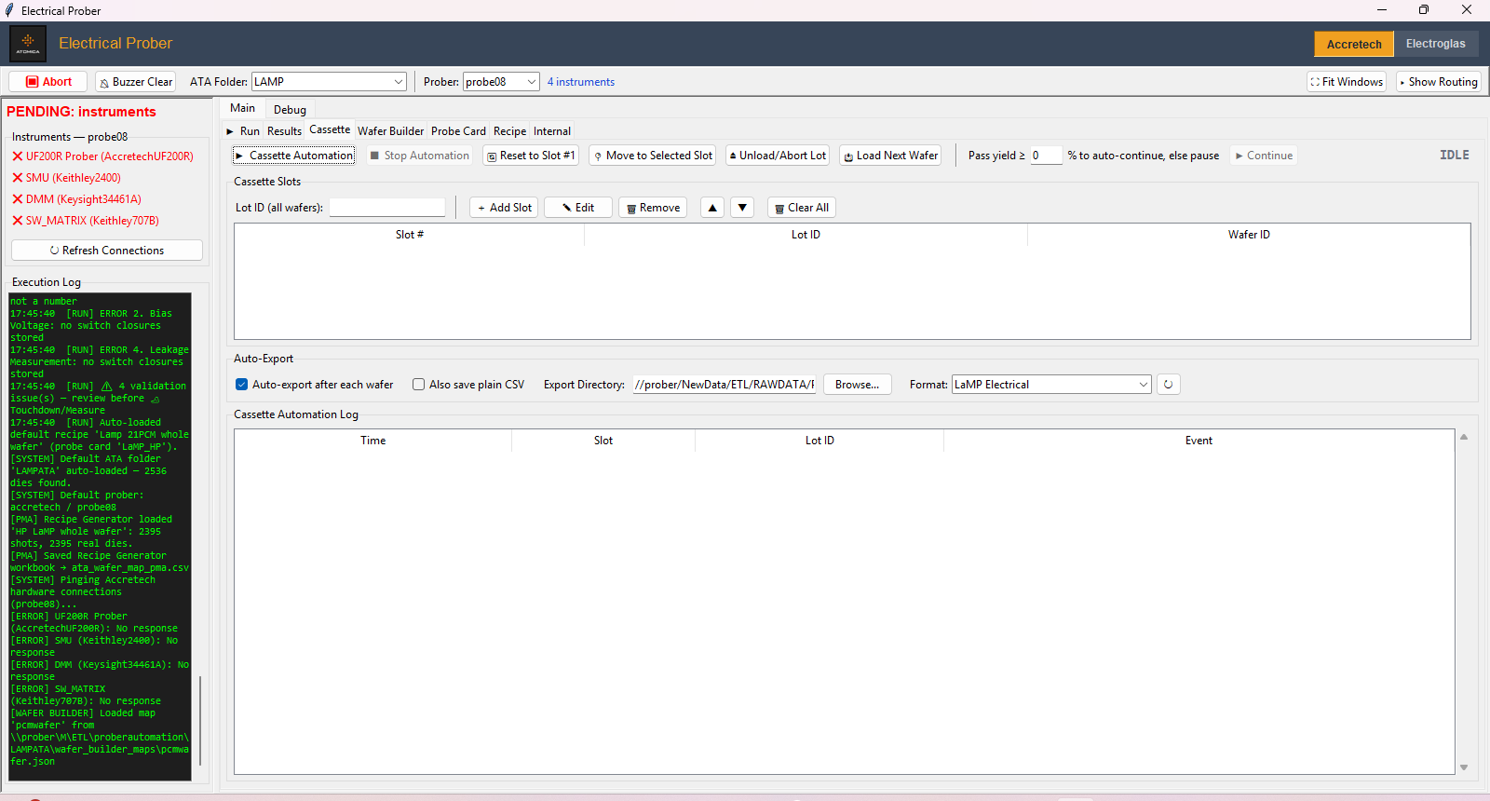
UNATTENDED OPERATION
Running Many Wafers Without a Person Watching
Production testing rarely means one wafer at a time. A cassette holds a whole stack of wafers, and the software can load, test, unload, and move to the next one entirely on its own.
A configurable yield threshold decides whether to keep going automatically or pause for a person to look - letting one operator supervise many wafers instead of babysitting each one.
Cassette automation - unattended, multi-wafer runs
10

Slide 11

PROJECT ORGANIZATION
Everything for One Product, in One Folder
Every product/test program gets its own self-contained folder: its probe cards, its recipes, its wafer maps, its default settings - all in one place.
That folder can be copied, backed up, or handed to another bench wholesale, and the software shows exactly what it found (and what's missing) at a glance instead of requiring a manual file hunt.
Everything for one product, organized and visible in one place
11

Slide 12
OUTCOME
What the Rewrite Actually Bought Us
▸ Retired an unsupported operating system — the Electroglas side no longer depends on Windows XP - one less unpatched machine on the network.
▸ Turned a hardcoded system into a configurable one — building a new product is now a matter of filling in a probe card, a wafer map, and a recipe on screen, not writing new software.
▸ No more per-seat LabVIEW licensing — the whole application runs on free, open tools.
▸ A real, readable codebase — changes are tracked, reviewed, and reversible - not buried in a proprietary block-diagram file.
▸ Easier to hand off — Python is a skill far more engineers already have than a niche graphical language.
12

Slide 13
LOOKING AHEAD
Where Else This Could Go
Beyond the wafer map itself, the rest of the architecture - GPIB-driven instruments and step-by-step recipes - fits any bench-style automated test.
▸ Other wafer probers or prober brands — any station that steps across a grid of positions running electrical tests is the same problem with different geometry - the wafer map engine carries over directly.
▸ Burn-in and reliability test racks — many parts, each stepped through a fixed sequence of stress/measure steps over time.
▸ PCB / module functional test benches — swap the wafer map for a fixture of board positions; everything else - instrument driving, recipes, pass/fail, export - carries over.
▸ RF and optical test setups — same GPIB/instrument-driver backbone, different measurement types.
▸ Any lab process still running on old, unsupported machines or one engineer's hardcoded program — is a candidate for the same kind of rebuild.
13

Slide 14
Same hardware. Modern, configurable software.
Questions / discussion
14

